Slide 1

Java Programming
Classes & Objects
对象和类

Slide 2
How to describe the student(s)?
String studentId=“001”;
String names=“Clinton”;
double height=1.88;
double weight=75;
String[] studentId={“001”,”002”,”003”,”004”};
String[] names={“Clinton”,”Obama”,”Trump”,”Bush”};
double[] height={1.88,1.9,1.78,1.76};
double[] weight={75,74,83,77};

Slide 3
How to describe the student(s)?
Is it a good ways to describe the student(s)?
Can we use one variable to store to store the information of one student?
Can we use one array to store the information of all the students?

Slide 4
Outline
Object oriented programming
Class declaration
Constructing objects
The new operator
Automatic Garbage Collection
BMI problems
More about classes
Multiple classes in one file
Nested classes
local classes
anonymous classes
JVM internals*
UML*

Slide 5
Object oriented programming
In classic procedural programming you try to make the real world problem you‘re attempting to solve fit a few, predetermined data types(预定义类型): integers, floats, Strings, and arrays perhaps.
In object oriented programming (OOP) you can create a model for a real world system by defining your own data types.

Slide 6
Class & Object
Classes are programmer-defined types(程序员自定义类型) that model the parts of the system.
A class has two parts: the fields and the methods.
Fields describe what the class is.
Methods describe what the class does.
The fields and methods are collectively called members(成员) of the class.
Using the blueprint provided by a class, you can create any number of objects, each of which is called an instance of the class.

Slide 7
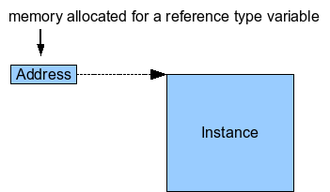
Class & Object
A Class is a reference type which can be defined by programmers.
Object is the instance of a class.
int[] a = new int[5];
String s= new String(“Hello”);
new

Slide 8

Object oriented programming
“In my 20 years in this industry, I have never seen a revolution as profound as this.”
— Steve Jobs, on object-oriented programming
The Rolling Stone Interview(1994)
Notes:
https://www.rollingstone.com/culture/news/steve-jobs-in-1994-the-rolling-stone-interview-20110117

Slide 9
Defining a class: Student
//Student.java
public class Student{
private String id; //instance variable(实例变量)
private String name;
private double weight;
private double height;
private static int studentNum; //class variable(类变量)
public final static String SCHOOL= “HIT”; //Constants(常量)
//constructor method(创建方法)
public Student(String id){
this.id = id;
}
}

Slide 10
Creating Student objects
To instantiate an object in Java, use the keyword new followed by a call to the class's constructor.
Student s1 = new Student(“1170611003”);
Student s2 = new Student(“1170611004”);

Slide 11
Class declarations(类的定义)
In general, class declarations can include these components, in order:
Modifiers, public, or package-private (no explicit modifier).
The class name, with the initial letter capitalized by convention.
The class body, surrounded by braces, {}.

Slide 12
Class declarations
A Java source file can contain multiple classes.
When the source file contains multiple classes, you can make one class "public" and name the source file with that public class name.
The compiler will generate a class file for each class defined in the source file.

Slide 13
Define multiple Classes in a file
//OOBMI.java
public class OOBMI{
}
class Student{
}
Notice:
Class Student is also in the file OOBMI.java, and the keyword public is optional for class OOBMI.

Slide 14
Member variables(成员变量)
Member variables are also called fields(域).
They are declared in a class definition, usually before the method definitions.
Field declarations are composed of three components, in order:
Zero or more modifiers.
access modifiers(访问修饰符)
static
final
The field's type.
The field's name.

Slide 15
Access Modifiers(访问修饰符)
Access Modifiers lets you control what other classes have access to a member field or method. There are 4 kinds of access modifiers:
public
the field or method is accessible from all classes.
private
the field or method is accessible only within its own class.
package-private (no explicit modifier)
the field or method is accessible from the package, the default access modifier.
protected
the field or method is accessible only within its own package.

Slide 16
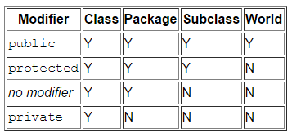
Access Modifiers
There are two levels of access control:
At the top (class) level—public, or package-private (no explicit modifier).
At the member level—public, private, protected, or package-private (no explicit modifier).

Slide 17

Access Modifiers – class level
//A.java
package p1;
public class A {
}
class B {
}
//C.java
package p1;
class C {
}
//D.java
package p2;
import p1.A;
Import p1.B;
import p1.C;
public class B {
}

Slide 18
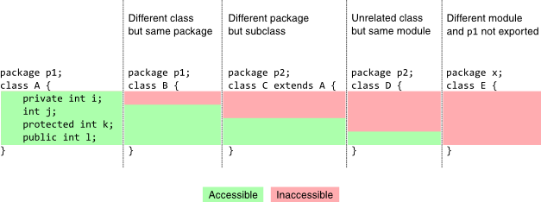
Access Modifiers – member level
Notice: Class A, B, C, D and E are public class

Slide 19
Tips on member access modifiers
Use private unless you have a good reason not to. Avoid public fields except for constants.
Access modifiers help keep classes isolated from each other so that changes in one class won’t require changes in other classes.
This will help us to develop robust program.
Notice:
Many of the examples in the lectures use public fields. This may help to illustrate some points concisely, but is not recommended for production code.

Slide 20
The static modifier
In addition to access modifiers, you can declare a field or a method to be static.
The members can be divided into two kinds:
Instance members (without static modifier )
Static members (with static modifier)
The static members belong to the class rather than object of the class
The static members can be accessed without the need of creating an instance of the class.
Can you give me an example of static member?
Notes:
例如System.out.println中out为static

Slide 21
The static modifier
for the member variables, they can be divided into:
Instance variables (without static modifier )
Class variables (with static modifier )
Notice: the local variables can not be declared to be static.

Slide 22
Instance variables(实例变量)
Instance variables are fields without static modifier.
When a number of objects are created from the same class blueprint, they each have their own distinct copies of instance variables.
They are created when you construct an object and reclaimed when the object is garbage-collected.
When you declare a Instance variable without assigning it an explicit value, the Java compiler will assign a default value.

Slide 23
Default values of Instance variables
Integer numbers have default value: 0
for int type: 0
for byte type: (byte) 0
for short type: (short) 0
for long type: 0L
Floating point numbers have default value: 0.0
for float type: 0.0f
for double type: 0.0d
Boolean variables have default value: false
Character variables have default value: ‘\u0000’ (space)
Object references have default value: null
Notice: This default initialization applies for instance variables, not for method variables. For variables in method, we have to initialize them explicitly.

Slide 24
Class variables(类变量)
Class variables are identified by the keyword static.
Class variables are also called static fields.
Class variables are shared across all instances of the class.
They are created when the program begins (or when the class is used for the first time) and survive until the program ends.

Slide 25
What is the output?
class Counter{
int count=0; //will get memory when instance is created
Counter(){
count++;
System.out.println(count);
}
public static void main(String args[]){
Counter c1=new Counter();
Counter c2=new Counter();
Counter c3=new Counter();
}
}

Slide 26
What is the output?
class Counter2{
static int count=0;//will get memory only once and retain its value
Counter2(){
count++;
System.out.println(count);
}
public static void main(String args[]){
Counter2 c1=new Counter2();
Counter2 c2=new Counter2();
Counter2 c3=new Counter2();
}
}

Slide 27
Constants(常量)
The static modifier, in combination with the final modifier, is also used to define constants.
By convention, the names of constant values are spelled in uppercase letters. If the name is composed of more than one word, the words are separated by an underscore (_).
If a primitive type or a string is defined as a constant and the value is known at compile time, the compiler replaces the constant name everywhere in the code with its value.

Slide 28
Member Methods(成员方法)
After declaring the member variables, the next step is to define the member methods that manipulate the member variables.

Slide 29
Method declarations
Method declarations are composed of six components, in order:
Zero or more modifiers.
The method's return type.
The method's name.
The parameter list in parenthesis.
An exception list — to be discussed later.
The method body, enclosed between braces.
Like the member variables, member methods can also be divided into two kinds:
Instance method
Class method (or static method)

Slide 30

Instance & Class Method
Instance methods
Instance methods can access instance variables and instance methods directly.
Instance methods can access class variables and class methods directly.
Class methods
Class methods can access class variables and class methods directly.
Class methods cannot access instance variables or instance methods directly.
Also, class methods cannot use the this keyword as there is no instance for this to refer to.
Notes:
非常重要，如果不理解面向对象原理，需记住该语法要求

Slide 31
Constructor method
A constructor creates a new instance of the class. It initializes all the variables and does any work necessary to prepare the class to be used.
Constructor declarations look like method declarations—except that they use the name of the class and have no return type.
Constructor is invoked by new operator
If you do not declare a constructor, the compiler will insert a default constructor that takes no arguments.

Slide 32
Constructor method
public Student(String id, String name, double h, double w){
this.id = id; //with keyword this, dot notation
this.name = name;
weight = w; // without keyword this
height = h;
studentNum++;
}
public Student(String id){
this.id = id;
studentNum++;
}

Slide 33
Keyword this and dot notation
Within an instance method or a constructor, “this” is a reference to the current object — the object whose method or constructor is being called.
The keyword “this” can be omitted if there is no confusion.
To access an attribute or a method of an object, Java uses dot notation(圆点记法).

Slide 34
Overloading(重载)
If two methods do the same thing, it is natural to give them the same name.
Having more than one method with the same name is called overloading, and it is legal in Java as long as each version takes different parameters.
Notice:
The compiler does not consider return type when differentiating methods, so you cannot declare two methods with the same signature even if they have a different return type.

Slide 35
The setter and getter methods
In general, almost all member variables should be declared private, then you can use setters and getters to access the member variables as required.
public String getName() {
return name;
}
public void setHeight (double height) {
this.height=height;
}
public double getHeight() {
return this.height;
}
…

Slide 36
Quiz: define your own Date class
Write a class definition for Date, an object type that contains three integers: year, month, and day.
The constructor take parameters named year, month and day, and use them to initialize the instance variables.
Provide the equals method to determine whether two Date objects are equal.
Provide the toString method to print the date using the date format in Chinese (e.g. “2017年9月1日”).
Test the above methods in the main method.

Slide 37
Constructing objects with new
To instantiate an object in Java, use the keyword new followed by a call to the class's constructor.
Student s1 = new Student(“1160611003”);
Student s2 = new Student(“1160611004”,”Donald Trump”,1.86,75.5);

Slide 38

Look inside the object
Different objects of the same class have the same fields and methods, but the values of the fields will in general differ.
Every object has a separate block of memory to store its fields, but the bytes in the methods are shared between all objects in a class.

Slide 39
Automatic garbage collection
Automatic garbage collection(自动垃圾回收) is the process of looking at memory, identifying which objects are in use and which are not, and deleting the unused objects.
In a programming language like C, allocating and deallocating memory is a manual process.
In Java, process of deallocating memory is handled automatically by the garbage collector.

Slide 40
When to use new operation?
Scenario 1:
When accessing the instance members (fields or methods or classes) of a different class
Scenario 2:
When a static member accessing the instance members (fields or methods or classes) of the same class
Notes:
非常重要，如果不理解面向对象原理，需记住该语法要求

Slide 41
Accessing the instance members
public static void main(String[] args) {
Student s = new Student(“1160611004”,”Donald Trump”,1.88,65.5);
s.setName("Donald J.Trump");
s.setHeight(1.86);
s.setWeight(75.5);
}

Slide 42
The null value
When you create an object variable, remember that you are storing a reference to an object.
In Java, the keyword null is a special value that means “no object”. You can declare and initialize an object variables as below:
Student s = null
And you can use bellow expression to check whether an object is null
s==null
Note: If you try to use a null value, either by accessing an attribute or invoking a method, Java throws a NullPointerException (an runtime error).

Slide 43
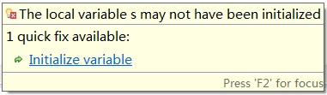
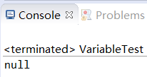

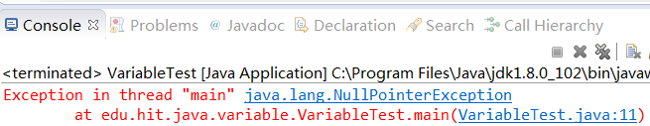
The null value
String s;
System.out.println(s);
s=null;
System.out.println(s);
System.out.println(s.toString());
Notes:
Notice: Variables must be initialized (assigned for the first time) before they can be used!

Slide 44
Encapsulation(封装)
So far, we have introduce one of three very important features about OOP, which is called encapsulation.
A language construct that facilitates the bundling of data with the methods (or other functions) operating on that data .
A language mechanism for restricting direct access to some of the object's components.
Encapsulation is often used interchangeably with information hiding(信息隐藏).
https://en.wikipedia.org/wiki/Encapsulation_(computer_programming)
https://en.wikipedia.org/wiki/Information_hiding

Slide 45

BMI statistics problem
Input ID, name, height and weight of each student
Store the above information into a text file
Calculate the BMI of each student
Sort the student by each attribute in ASCENDING or DESCENDING order
Calculate the range, mean, media, mode the BMIs
According to the values, divide BMIs into ten same size range, and count the students in each range, lastly print the number of students in each range on the screen
Draw a histogram to show the distribution of the BMIs

Slide 46
Sort students by height
public class BMI{
public static void main(String[] args){
String[] names={“Clinton”,”Obama”,”Trump”,”Bush”};
double[] height={1.88,1.9,1.78,1.76};
int[] sorted=sort(height);
for(int i=0;i<sorted.length;i++)
System.out.println(names[sorted[i]]+”\t”+ height[sorted[i]]);
}
public static int[] sort(double[] items){…}
}

Slide 47
Refactor the BMI classes
public class BMI {
private Student[] students;
public void genStudents(){…}
public void sortStudentbyHeight(){…}
…
public void showStudents(){…}
public static void main(String[] args) {
BMI bmi = new BMI();
bmi.genStudents()
bmi.sortStudentbyHeight();
bmi.showStudents();
}
}

Slide 48
Generate students randomly
public Student[] genStudents(int N) {
Student students[] = new Student[N];
Random r = new Random();
double x=0.0;
for(int i=0;i<N;i++){
x=r.nextGaussian();
Student st= new Student(
String.format("%04d",i),
genRandomString(6),(1.75+x*0.1),(60.0+x*5));
students[i]=st;
}
return students;
}
Notes:
方法调用返回下一个伪高斯(“正态地”)分布的均值为0.0，标准差为1.0从此随机数生成器的序列的double值。

Slide 49
JVM internals* Java虚拟机剖析

Slide 50
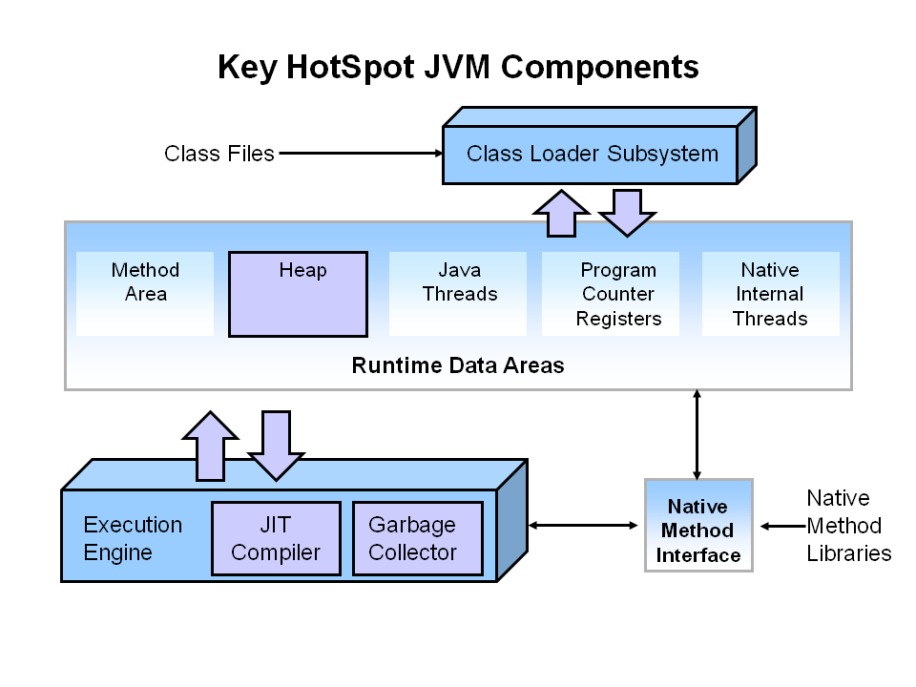
JVM internals
http://www.oracle.com/webfolder/technetwork/tutorials/obe/java/gc01/index.html
Notes:
The main components of the JVM include the classloader, the runtime data areas, and the execution engine.

Slide 51
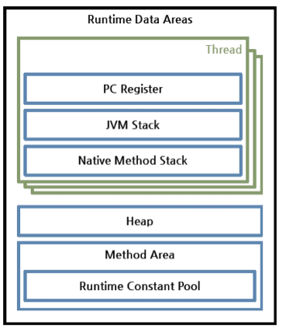
JVM internals
The Java Virtual Machine defines various run-time data areas that are used during execution of a program.
http://docs.oracle.com/javase/specs/jvms/se7/html/jvms-2.html#jvms-2.5

Slide 52
Method area(方法区)
The Java Virtual Machine has a method area that is shared among all Java Virtual Machine threads.
It stores per-class structures such as the run-time constant pool, field and method data, and the code for methods and constructors, including the special methods used in class and instance initialization and interface initialization.
If memory in the method area cannot be made available to satisfy an allocation request, the Java Virtual Machine throws an OutOfMemoryError.

Slide 53
Run-time constant pool(常量池)
A run-time constant pool is a per-class or per-interface run-time representation of the constants in a class file.
It contains several kinds of constants, ranging from numeric literals known at compile-time to method and field references that must be resolved at run-time.

Slide 54
Run-time constant pool vs String pool
"Constant pool" refers to a specially formatted collection of bytes in a class file that has meaning to the Java class loader. The "strings" in it are serialized, they are not Java objects. There are also many kinds of constants, not just strings in it.
In contrast, the "String pool" is used at runtime (not just during class loading), contains only strings, and the "strings" in the string pool are java objects.
https://stackoverflow.com/questions/23252767/string-pool-vs-constant-pool
Notes:
http://java-performance.info/string-intern-in-java-6-7-8/

Slide 55
Evolution of String pool
In those good old days all interned strings were stored in the PermGen. PermGen is a fixed size part of heap mainly used for storing loaded classes and string pool. PermGen has a fixed size and can not be expanded at runtime.
Oracle engineers made an extremely important change to the string pooling logic in Java 7 – the string pool was relocated to the heap.
String pool values are garbage collected
http://java-performance.info/string-intern-in-java-6-7-8/

Slide 56
Heap(堆)
The heap is created on virtual machine start-up.
Heap is shared among all Java Virtual Machine threads.
It is the run-time data area from which memory for all class instances and arrays are allocated. objects are never explicitly deallocated.
Object exist as long as we have a reference. If the Heap memory area can’t be reached through a reference the Garbage Collector will release that space.
If there are not enough memory space that the computation requires in the heap, the JVM throws a OutOfMemoryError.

Slide 57
JVM Stacks(栈)
each method has its own stack
It holds local variables and partial results, and plays a part in method invocation and return.
the stack size is fixed and it is determined in the compiler phase based on variables declaration and other compiler options;
a method stack exists only during the lifetime of that method: from the calling moment until the return moment;
If the computation requires a larger JVM stack than is permitted, the JVM throws a StackOverflowError.

Slide 58
Case study
class Student{
int age;
String name;
public Student(int Age, String Name)
{
this.age = Age;
setName(Name);
}
public void setName(String Name)
{
this.name = Name;
}
}
public static void main(String[] args) {
Student s;
s = new Student(23,"Jonh");
int noStudents = 1;
}
}

Slide 59
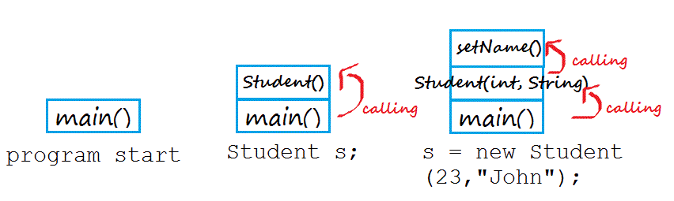
Stack

Slide 60
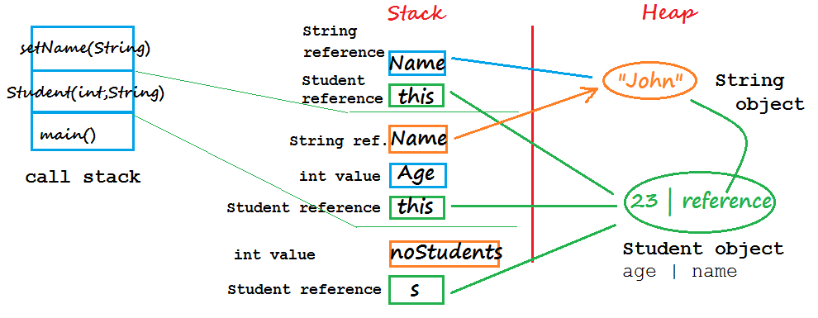
Stack and Heap

Slide 61
More about classes 类的高级用法

Slide 62
Instance Initialization Blocks
In Java, we can put a piece of code inside a block enclosed within { and }.
public class Dog {
// instance initialization block
{
System.out.println("Dog's Instance Init Block");
}
public Dog() {
System.out.println("Dog's constructor");
}
}

Slide 63
Instance Initialization Blocks
The instance initialization block is executed every time an instance of the class is created and after the call to super() in the constructor.
For example:
Dog dog = new Dog();
The output is:
Dog's Instance Init Block
Dog's constructor
Note: we will talk about super() in the next lecture.
Notes:
The execution flow looks like as below:
public Dog() {
call super();
executed the instance initialization block;
System.out.println("Dog's constructor");
}
There can be multiple instance initialization blocks in a class, and they are executed in the order they appear.

Slide 64
Static Initialization Blocks
Note: An static instance initialization block is executed only once when the class is first loaded, whereas an instance initialization block is executed every time an instance is created.
public class Bird {
// static initialization block
static {
System.out.println("Bird's Static Init Block");
}
public Bird() {
System.out.println("I'm a bird");
}
}

Slide 65
Nested Classes(嵌套类)
Java allows you to define a class within another class. Such a class is called a nested class.
A nested class is a member of its enclosing class.
A nested class can be declared private, public, protected, or package private. (Recall that outer classes can only be declared public or package private.)

Slide 66
Nested Classes
Nested classes are divided into two categories: static and non-static.
Nested classes that are declared static are called static nested classes(静态嵌套类).
Like the static method, static nested classes can access to the static members of the enclosing class directly, can not access to the instance members directly!
Non-static nested classes are called inner classes(内部类).
inner classes have access to other members of the enclosing class, even if they are declared private.

Slide 67
Nested Classes
class OuterClass {
int outer = 0;
...
static class StaticNestedClass {
...
}
class InnerClass {
outer = 1;
...
}
}

Slide 68
Initialize Nested Classes
public class BMI{
...
public void BMI() {
...
HeightComparator hc = new HeightComparator();
…
}
public static void main(String[] args) {
BMI bmi = new BMI();
BMI.HeightComparator myHc = bmi.new HeightComparator()
bmi.sortStudents(myHc);
…
}
private class HeightComparator{
...
}
}
Notes:
本程序中HeightComparator myHc= bmi.new HeightComparator()也正确，也因在一个类中；
如果另一个类中要声明HeightComparator类型的变量，必须加BMI.

Slide 69
Local classes(局部类)
Local classes are classes that are defined in a method, rather than as a member of a class.
A Local class must be package private(no modifier).
A Local class cannot declare any static members.
A local class may have access to the members of its enclosing class.
Local classes in static methods can only refer to static members of the enclosing class

Slide 70
Local classes
public class StaticMemberTest {
static String ss = getStaticString();
String nss = "non static string";
public static String getStaticString(){
String ss = "static string";
class LocalClass{//A local class must be package private
String localClassMethod(){
return ss;
}
}
return new LocalClass().localClassMethod();
}
}

Slide 71
Anonymous Classes(匿名类)
Anonymous classes enable you to declare and instantiate a class at the same time.
Anonymous classes looks like local classes except that they do not have a name.
Use them if you need to use a local class only once.
We will introduce it in the next chapter.

Slide 72
Reading materials
http://docs.oracle.com/javase/tutorial/java/javaOO/nested.html
http://docs.oracle.com/javase/tutorial/java/javaOO/localclasses.html
http://docs.oracle.com/javase/tutorial/java/javaOO/anonymousclasses.html

Slide 73
Unified Modeling Language* 统一建模语言

Slide 74

UML(统一建模语言)
Modeling is the designing of software applications before coding. Modeling is an Essential Part of large software projects, and helpful to medium and even small projects as well.
Unified Modeling Language (UML) helps you specify, visualize, and document models of software systems, including their structure and design.
UML standards are maintained by OMG (Object Management Group, Inc.)

Slide 75
UML
UML 2.0 defines thirteen types of diagrams, divided into three categories:
Structure Diagrams include
the Class Diagram, Object Diagram, Component Diagram, Composite Structure Diagram, Package Diagram, and Deployment Diagram.
Behavior Diagrams include
the Use Case Diagram (used by some methodologies during requirements gathering); Activity Diagram, and State Machine Diagram.
Interaction Diagrams (all derived from the more general Behavior Diagram) include:
the Sequence Diagram, Communication Diagram, Timing Diagram, and Interaction Overview Diagram.
Notes:
http://www.uml.org/what-is-uml.htm#12DiagramTypes

Slide 76
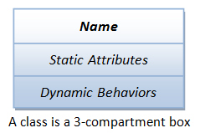
Class diagram
In UML, a class can be visualized as a three-compartment box, as illustrated:
Notice: the word “static” here is not the java keyword “static”!

Slide 77
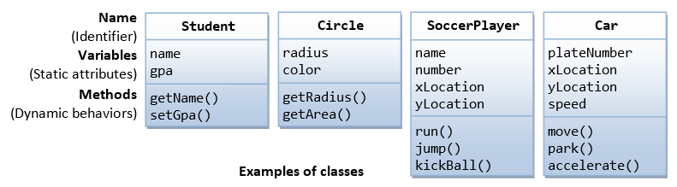
Class diagram
The followings figure shows a few examples of classes:
http://www.ibm.com/developerworks/rational/library/content/RationalEdge/sep04/bell/
http://www.sparxsystems.com.au/resources/uml2_tutorial/uml2_classdiagram.html

Slide 78
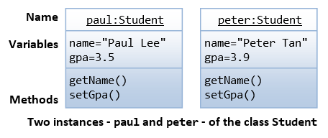
Object diagram
An instance is also represented as a 3-compartment box, with instance name shown as instanceName: Classname and underlined.

Slide 79
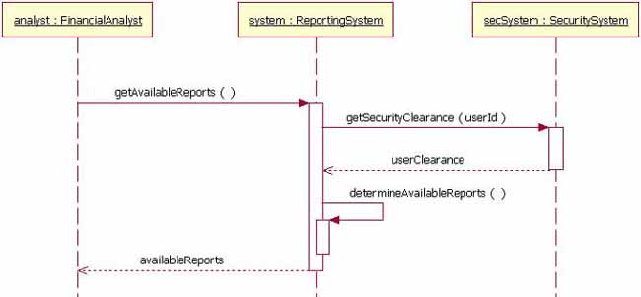
Sequence Diagram
A Sequence diagram is an interaction diagram that shows how objects operate with one another and in what order.
instance
message
object lifeline
method-invocation box
return message
http://www.ibm.com/developerworks/rational/library/3101.html
http://www.sparxsystems.com.au/resources/uml2_tutorial/uml2_sequencediagram.html

Slide 80

Summery of Classes & Objects
A class is a type or a template, a class includes attributes and behaviors
An object is an instance of a class

Slide 81


